Slide 1


Wear Your Style, Virtually!

Slide 2
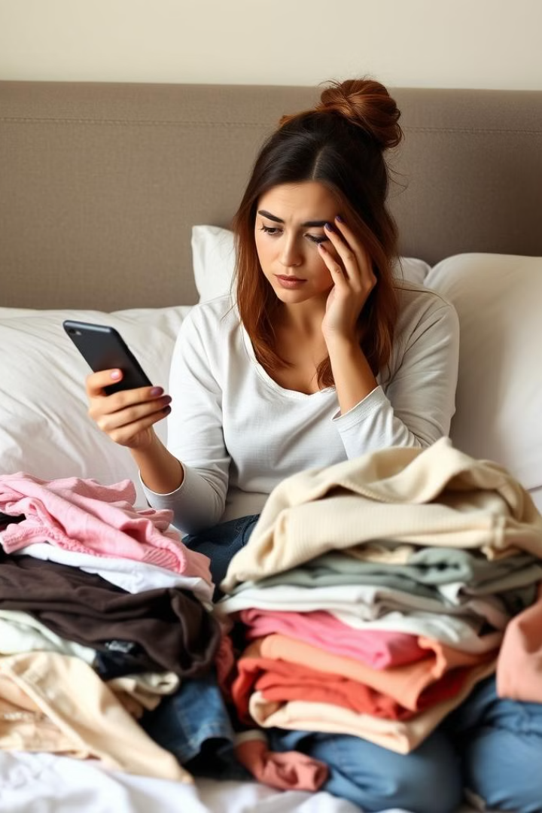
The Problem: Uncertainty in Online Shopping
1
High Return Rates
Mismatched sizes and unexpected fits lead to frequent returns, causing frustration and financial losses.
2
Limited Visualization
Shoppers struggle to imagine how clothes will look and fit without trying them on.
3
Lost Confidence
Uncertainty hinders confidence in online shopping, particularly for fashion-conscious consumers.
4
Gap in Experience
The difference between physical stores and online shopping creates a significant obstacle for both consumers and retailers.

Slide 3
The Solution: OutFitMe
Virtual Try-On
AI-Powered Accuracy
Realistic Visualization
Users upload or select an avatar and try on clothes virtually, seeing how they fit and look.
Our AI-based image recognition technology accurately maps clothing onto users' body shapes.
OutFitMe provides a realistic view of how outfits will look, eliminating the guesswork and frustration of online shopping.

Slide 4
Key Features of OutFitMe
1
AI-Based Recommendations
2
User-Friendly Interface
3
Custom Image Support
OutFitMe suggests outfits based on user preferences, and trending styles.
The app's intuitive design seamlessly transitions between “Try-On” and “Buy Now” options.
Users can upload images that closely resemble their body shape, ensuring a personalised experience.
4
Real-Time Feedback
The system processes try-on requests instantly, providing a responsive and interactive experience.

Slide 5
Technical Foundation
Platform
AI-Powered Virtual Try-On
Database Integration
Flask powers the backend, while HTML, CSS, and JavaScript create a seamless frontend experience.
MySQL securely stores user information, outfits, and try-on data, ensuring smooth functionality across the app.
We integrated CP-VTON, a state-of-the-art virtual try-on network, to accurately map clothing onto body shapes using python.

Slide 6
Research & Development
Virtual Try-On Technology
CP-VTON architecture utilizes conditional generative adversarial networks (cGANs) to generate realistic try-on results.
Human Parsing
Image segmentation techniques separate body parts for more accurate outfit mapping.
Deep Learning
Research on deep learning and computer vision powers cloth segmentation and image transfer.
E-Commerce Insights
Research on customer behavior guides the development, addressing challenges like clothing returns and the impact of virtual try-ons on sales.

Slide 7



Acknowledgements
CP-VTON Developers
Open-Source Community
Our Dedicated Team
Their open-source code formed the foundation of our virtual try-on system.
We are grateful for the freely available machine learning models and datasets.
Their tireless work modified and customized the solution to fit our application needs.

Slide 8




Future Enhancements
AR Integration
Style Prediction
Expanded Product Range
Enhanced Personalization
We plan to integrate augmented reality (AR) for live try-on experiences, using smartphone cameras to map clothing in real time.
AI-based fashion forecasting will recommend trending outfits based on seasonal changes and global fashion trends.
Adding more clothing brands and styles to expand the variety offered on the platform.
Further development of personalized AI-based shopping recommendations, tailoring outfits to user tastes, body types, and preferences.

Slide 9
Thank You

